Slide 1
Samba Commerce
Company-Wide Dashboard
Margianto Ramadhani
Week 11&12 - RevoU FSDA JAN23

Slide 2
Dashboard Objectives
Build an Company-Wide Dashboard of Samba Commerce to understand the business performance better through any essential metrics.
WHO IS THE USER(S) OF THE DASHBOARD?
CEO of Samba Commerce as the main user.
Other Executives can also use the dashboard for occasional purposes.
WHY DOES USER(S) NEED THE DASHBOARD?
They need to get the information about business performance of Samba Commerce and get insights from the dashboard.
WHAT IS ONE USE CASE EXAMPLE?
The CEO wants to know the business growth over the last year as well as the internal and external variables that can affect the growth of his business.
The CEO can use the dashboard to check Overall condition of the business and trends in business growth over time.
*assuming we already discussed all these questions with CEO and all stakeholders

Slide 3
Looker Studio

Slide 4
Creating Dashboard
1
2
3
4
UNDERSTAND THE BUSINESS REQUIREMENTS & DEFINE DASHBOARD OBJECTIVES
Users: CEO, and other executives
Why: They need to get the information about overall condition of Samba Commerce business
IMPORT, BLEND/JOIN, & PREPARE DATASETS
First, we need to import then check the datasets, is it cleaned? Are all the data types correct? Can we create new variable/feature engineering?
Then, we need to blend/join the datasets so the variables between each dataset can be aggregated across datasets given, in example we can aggregate variable from dataset A grouped by variable from dataset B.
CALCULATE & VISUALIZE THE METRICS NEEDED
All metrics needed are already stated in the brief and we should choose how to best visualize the metrics.
LAYOUT & FINALIZE THE DASHBOARDS
After all visualizations are ready, then we can start layouting the dashboards.
We also create filters to ease using the dashboard.
All charts and visualizations also can be used as filter for the others(cross-filtering) to make the dashboards more interactive.

Slide 5
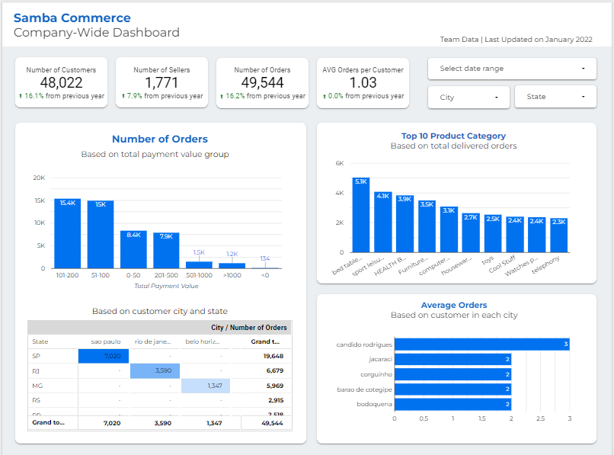
How will user(s) use the dashboard?
Looker Studio Dashboard
Link to Dashboard
3. Scorecards
Give quick insights from the key metrics in the business such as: number of customers, number of sellers, number of orders and overall avg orders per customer, including the percent difference from the last year.
1
1. Dashboard Title
Give information such as: what kind of dashboard, team/ person in charge, and data last updated time
3
2
4
6
2. Control Filter
Filter the data for more detailed preferences. On this dashboard, users can filter based on time-period, city and state
4. Number of Orders Based on Total Payment Group
To find which payment value group has the most number of orders
5
7
4-7. Charts & Visualizations
Deep dive in more detail by looking into the charts and visualizations. From the titles and subtitles on each charts, we can understand how the metrics and numbers are calculated.
5. Number of Orders Based on Customer State and City
To find which state per city has the highest of total orders
6. Top 10 Product Category
To find the top 10 product category based on total delivered orders
7. Average Orders per Customer
To find the average orders based on customer in each city

Slide 6
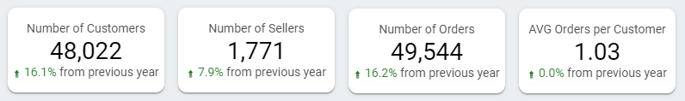
Looker Studio Dashboard - Findings/Insights #1
For the past year since its launch in 2021 with Last update data until January 2022 we got with the following summary :
1. Total customer is 48022 with increasing customer 16.1% from last year.
2. Total sellers is 1771 with increasing sellers 7.9% from last year.
3. Total orders is 49544 with increasing orders 16.2% from last year.
4. Average orders per customer is 1.03 without any significant increase from last year.
Based on the results of existing data, the increase in the number of customers greatly affects the number of sellers and the total orders which can increase the company's revenue.

Slide 7
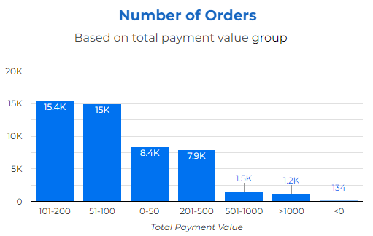
For the past year since its launch in 2021, we got the highest total orders is 15400 with the total payment range of 101-200. So that we can focus on orders that have a total payment around 101-200 and we can also consider at payment around 51-100 as a second place with a slight difference. From existing graphic there are 134 orders with a total payment <0 which indicates a loss for the company.
Looker Studio Dashboard - Findings/Insights #2

Slide 8
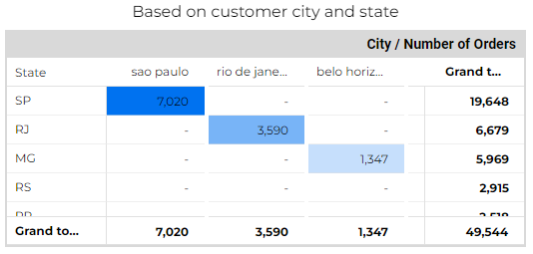
Since samba commerce launch, the highest total orders were in the city of Sao Paulo as many as 7020 orders which were in the SP state which had a total order is 19648. Based on this data, we can see that the best market opportunity lies with Sao Paulo to campaign and attract more customers for business growth.
Looker Studio Dashboard - Findings/Insights #3

Slide 9
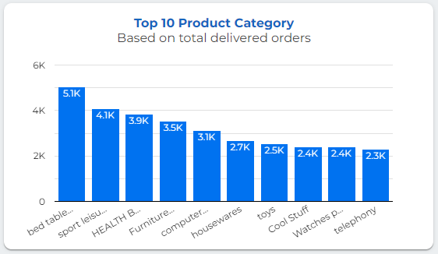
Since its launch last year, the top 10 product categories were ordered the most with bed table baths being the most ordered product with a total of 5052. We can focus more on the 10 products category in order to increase the number of orders and revenue for business growth.
Looker Studio Dashboard - Findings/Insights #4

Slide 10
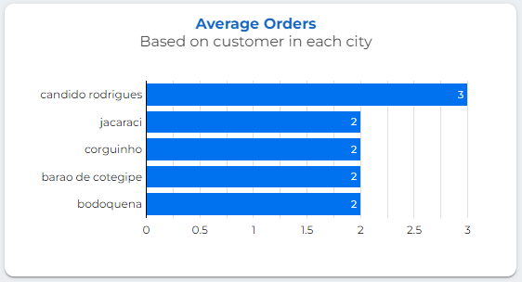
During this year, the average order per customer in each region was found that the highest average number of orders made by customers was in the city of Candido Rodrigues, with 3 orders per customer. From here we can find out which cities have active customers making repeated orders which can be the focus for conducting campaigns for business growth and increasing revenue.
Looker Studio Dashboard - Findings/Insights #5

Slide 11
Tableau Public

Slide 12
Creating Dashboard
1
2
3
4
UNDERSTAND THE BUSINESS REQUIREMENTS & DEFINE DASHBOARD OBJECTIVES
Users: CEO, and other executives
Why: They need to get the information about overall condition of Samba Commerce business
IMPORT, JOIN, & PREPARE DATASETS
First, we need to import then check the datasets, is it cleaned? Are all the data types correct? Can we create new variable/feature engineering?
Then, we need to join the datasets so the variables between each dataset can be aggregated across datasets given, in example we can aggregate variable from dataset A grouped by variable from dataset B.
CALCULATE & VISUALIZE THE METRICS NEEDED
All metrics needed are already stated in the brief and we should choose how to best visualize the metrics.
LAYOUT & FINALIZE THE DASHBOARDS
After all visualizations are ready, then we can start layouting the dashboards.
We also create filters to ease using the dashboard.
All charts and visualizations also can be used as filter for the others(cross-filtering) to make the dashboards more interactive.

Slide 13
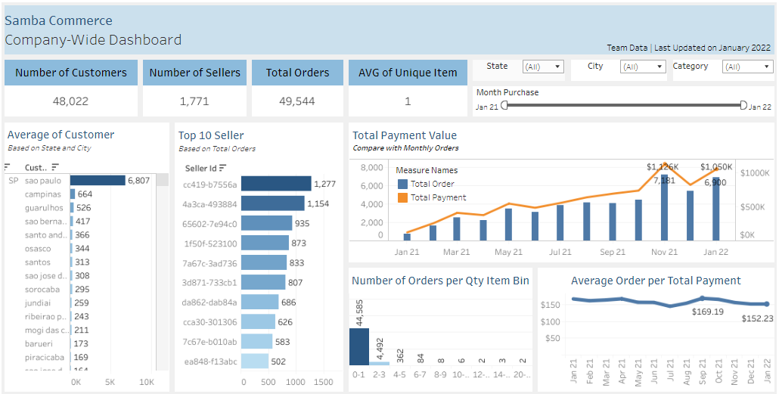
How will user(s) use the dashboard?
Tableau Dashboard
Link to Dashboard
3. Scorecards
Using scorecards, users can find quick insights from the key metrics in the business such as: number of customers, sellers, orders and average of unique items.
1
1. Dashboard Title
From the title, users can get information such as: what kind of dashboard, team/person in charge, data last updated time
2
3
4
5
6
4. AVG of Customer per State and City
Users can see which region has the most number of customer.
2. Control Filter
Using control filters, users can filter the data based on their needs. On this dashboard, users can filter based on month periode, state, city, and category
5. Top 10 Sellers per Total Order
Users can see the top 10 sellers with high total orders
8
7
4-8. Charts & Visualizations
Users can deep dive in more detail by looking into the charts and visualizations. From the titles and subtitles on each charts, they also can understand how the metrics and numbers are calculated.
6. Total Payment value
Users can see the comparation of total payment with total orders per month
7. Number of Orders per Qty Item Bin
Users can see total orders based on Qty per Bin
8. AVG Order per Total Payment
Users can see average order per total payment monthly

Slide 14

For the past year since its launch in 2021 with Last update data until January 2022 we got with the following summary : 1. Total customers is 48022. 2. Total sellers is 1771. 3. Total orders is 49544. 4. Average of unique item per customer is 1. Broadly speaking, based on total orders and the average unique item per customer, it is known that per customer only makes one transaction. So, it is necessary to have a campaign or promotion so that customers make repeated orders to be able to increase revenue and create business growth
Tableau Dashboard - Findings/Insights #1

Slide 15
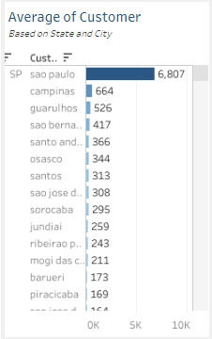
Since samba commerce launch, the highest average of customer were in the city of Sao Paulo as many as 6,807 customers which were in the SP state. Based on this data, we can see that the best market opportunity is in Sao Paulo, and we can focus to give the campaign and attract more customers in Sao Paulo for business growth
Tableau Dashboard - Findings/Insights #2

Slide 16
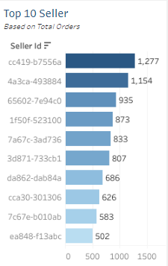
Based on existing data, it is known that there are 10 seller IDs with the most total orders since the launch. And it is known that Seller Id cc419-b7556a with the highest total orders at 1277. With this data, we can give appreciation to these sellers so that their performance increases and the business can continue to grow
Tableau Dashboard - Findings/Insights #3

Slide 17
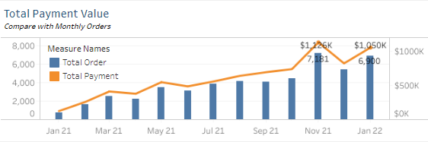
The highest total payment occurred in November 2021 of $ 1,126K with a total of 7,181 orders. Despite the decline in December, total payments increased again in January 2022 by $1,050K with 6,900 orders. Seeing these positive trends, we remain optimistic to be able to increase total payments in the following months by conducting campaigns and increasing promotions. so that revenue can continue to rise, and business continues to grow.
Tableau Dashboard - Findings/Insights #4
From the results of the comparison of total payments with total orders per month, it is known that the existing trends are almost the same as the positive trends with a slight difference. Where the total payment is affected by the total order, the higher the order, the higher the total payment and vice versa.

Slide 18
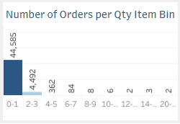
since the launch, it is known that the total existing orders consist of only 1 qty of 44585 orders, and in the 2-3 qty range there are only 4,492. From this it is known that the average customer only makes orders with a total qty of 1. So, it is necessary to carry out an in-depth analysis regarding this matter so that it can attract more customers to place orders with a higher total qty so that the business can continue to grow
Tableau Dashboard - Findings/Insights #5

Slide 19
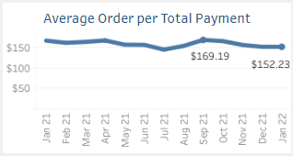
Based on the trending average orders value based on total payment each month, it is found that the trend tends to be stagnant with slight increases and decreases. It is known that the highest of average order value was in September 21 as much as $ 169.19 and tended to decrease until January 22 as much as $ 152.23.
Tableau Dashboard - Findings/Insights #6
From the graph it is known that the average monthly payment made by customers for orders made has been stagnant since the launch and there was even a slight decrease at the end of the January 2022 period. This needs to be our concern in order to persuade customers to actively place orders by means of campaigns or promotions.

